Slide 1
Discrete Mathematics
Xiaowei Yang
School of Software Engineering
South China University of Technology
Office Room: B7-218
E-Mail Address: xwyang@scut.edu.cn

Slide 2
Chapter 2. Logic and Proof, Sets, and Function
Sets
Section 2.1-2.2

Slide 3
Contents
1
Introduction of Sets
2
Power Sets
3
Set Operations
4
Set Identities, Generalized and Intersections
5
Computer Representation of Sets

Slide 4
Introduction of Sets

Slide 5
Introduction to Set Theory
A set is an unordered collection of objects.
Cantor’s work:
Paradoxes Axioms Naive set theory
Sets are ubiquitous in computer software systems.
All of mathematics can be defined in terms of the form of set theory.

Slide 6
The objects in a set are also called the elements, or members, of the set. A set is said to contain its elements.
Example 1: V={a,e,I,o,u}
Example 2: O={1,3,5,7,9}
Example 3: {a,2,Fred,New,Jersey}
Example 4:
N = {0, 1, 2, …} The Natural numbers.
Z = {…, -2, -1, 0, 1, 2, …} The integers.
Q={ p / q | p ∈ Z, q ∈ Z, q≠0} is the set of rational number.

Slide 7
Two sets are equal if and only if they have the same elements.
{1, 3, 5} and {3, 5, 1} are equal.
{1, 3, 3, 3, 5, 5, 5, 5} is the same as {1, 3, 5}
No matter what objects a, b, and c denote,
{a, b, c} = {a, c, b} = {b, a, c} = …
Multiple listings make no difference:
  {a, a, c, c, c, c}={a,c}.

Slide 8
Basic properties of sets
Set builder notation: For any proposition P(x) over any universe of discourse, {x|P(x)} is the set of all x such that P(x).
For example:
{1, 2, 3, 4} =
{x | x is an integer where x>0 and x<5 } =
{x | x is a positive integer whose square
is >0 and <25}

Slide 9
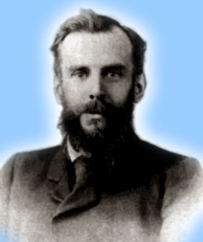
Venn/Euler Diagrams
John Venn
1834-1923
0
2
4
6
1
8
Even integers from 2 to 9
-1
3
5
7
9
Odd integers from 1 to 9
Positive integers less than 10
Primes <10
Integers from -1 to 9
Notes:
With Venn diagrams, you can see that one set is a subset of another just by seeing that you can draw an enclosure around its members that fits completely inside an enclosure drawn around the larger set’s members.

Slide 10
The Empty Set
We have seen that there exists exactly one empty set, so we can give it a name:
∅ (“the empty set”) is the unique set that contains no elements whatsoever.
∅ = {} = {x|x≠x} = ...
Any set containing exactly one element is called a singleton

Slide 11
Subset and Superset Relations
S⊆T (“S is a subset of T”) means that every element of S is also an element of T.
S⊆T :≡_{def} ∀x (x∈S → x∈T)
What do you think about these?
  ∅⊆S ?
  S⊆S ?
Notes:
Note also that FORALL x P(x)->Q(x) can also be understood as meaning “{x|P(x)} is a subset of {x|Q{x}}”. This can help you understand the meaning of implication. For example, if I say, “if a student has a drivers license, then he is over 16,” this is the same as saying “the set of students with drivers licenses is a subset of the set of students who are over 16”, or “every student with a drivers license is over 16.” If no students in the universe of discourse have drivers licenses, then the antecedent is always false, or in other words the set of students with drivers licenses is just the empty set, which is of course a member of every set, and so the statement is vacuously true. Alternatively, if every student in the universe of discourse is over 16, then the consequent is always true, that is, the set of students who are over 16 is the entire universe of discourse, and so every set of students in the u.d. is necessarily a subset of the set of students who are over 16, and so the statement is trivially true. The statement is only false if there exists a student with a drivers license in the u.d. who is under 16 (perhaps the license is fake or from a foreign country), in which case, the set of students with drivers licenses is *not* a subset of the under-16 students.

Slide 12
Subset and Superset Relations
S⊆T (“S is a subset of T”) means that every element of S is also an element of T.
S⊆T :≡_{def} ∀x (x∈S → x∈T)
What do you think about these?
  ∅⊆S ? Yes
  S⊆S ? Yes
Notes:
Note also that FORALL x P(x)->Q(x) can also be understood as meaning “{x|P(x)} is a subset of {x|Q{x}}”. This can help you understand the meaning of implication. For example, if I say, “if a student has a drivers license, then he is over 16,” this is the same as saying “the set of students with drivers licenses is a subset of the set of students who are over 16”, or “every student with a drivers license is over 16.” If no students in the universe of discourse have drivers licenses, then the antecedent is always false, or in other words the set of students with drivers licenses is just the empty set, which is of course a member of every set, and so the statement is vacuously true. Alternatively, if every student in the universe of discourse is over 16, then the consequent is always true, that is, the set of students who are over 16 is the entire universe of discourse, and so every set of students in the u.d. is necessarily a subset of the set of students who are over 16, and so the statement is trivially true. The statement is only false if there exists a student with a drivers license in the u.d. who is under 16 (perhaps the license is fake or from a foreign country), in which case, the set of students with drivers licenses is *not* a subset of the under-16 students.

Slide 13
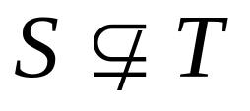
Subset and Superset Relations
More notation:
S⊇T (“S is a superset of T”) :≡_{def} T⊆S.
Note S=T ⇔ S⊆T∧ S⊇T.
:≡_{def} ¬(S⊆T), i.e. ∃x(x∈S ∧ x∉T)
Notes:
Note also that FORALL x P(x)->Q(x) can also be understood as meaning “{x|P(x)} is a subset of {x|Q{x}}”. This can help you understand the meaning of implication. For example, if I say, “if a student has a drivers license, then he is over 16,” this is the same as saying “the set of students with drivers licenses is a subset of the set of students who are over 16”, or “every student with a drivers license is over 16.” If no students in the universe of discourse have drivers licenses, then the antecedent is always false, or in other words the set of students with drivers licenses is just the empty set, which is of course a member of every set, and so the statement is vacuously true. Alternatively, if every student in the universe of discourse is over 16, then the consequent is always true, that is, the set of students who are over 16 is the entire universe of discourse, and so every set of students in the u.d. is necessarily a subset of the set of students who are over 16, and so the statement is trivially true. The statement is only false if there exists a student with a drivers license in the u.d. who is under 16 (perhaps the license is fake or from a foreign country), in which case, the set of students with drivers licenses is *not* a subset of the under-16 students.

Slide 14
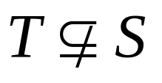
Proper (Strict) Subsets & Supersets
S⊂T (“S is a proper subset of T”) means that S⊆T but .
Example:{1,2} ⊂ {1,2,3}
We have {1,2,3} ⊆ {1,2,3},
but not {1,2,3} ⊂ {1,2,3}
Notes:
Here the understanding is that the blue/green area is empty!

Slide 15
Sets Are Objects, Too!
The elements of a set may themselves be sets.
E.g. let S={x | x ⊆ {1,2,3}}
then S = …
Notes:
In general, any kind of object or structure, whether simple or complex, can be a member of a set. In particular, sets themselves (being structures) can be members of sets.
If you don’t understand the distinction between 1, {1}, {{1}}, you’ll make endless silly mistakes. 1 is a number, the number one. {1} is NOT A NUMBER AT ALL! It is a COMPLETELY DIFFERENT TYPE OF OBJECT! Namely, it is a set. What kind of set? It is a singleton set, by which we mean a set that contains exactly one element. In this case, its element happens to be the number 1. Now, what is {{1}}? It is also a set, and also a singleton set, but it is a COMPLETELY DIFFERENT TYPE of singleton set. To see this, notice that {1} is a set of numbers, whereas {{1}} is not a set of numbers at all! It is a SET OF SETS. Its single element is not a number at all, but is a SET. Namely, the set {1}. In other words, {{1}} is the singleton set whose member is the singleton set whose member is 1. Whereas, {1} is just the singleton set whose member is 1. And, 1 is just 1. All of these are distinct objects and you’ve got to learn to keep them separate! Otherwise, you’ll never have a chance of understanding data types in programming languages. For example, in most languages, we can have an array of numbers, or an array of arrays of numbers, etc. These are all completely different types of objects and can never be compatible with each other.

Slide 16
Sets Are Objects, Too!
The objects that are elements of a set may themselves be sets.
E.g. let S={x | x ⊆ {1,2,3}}
then S={∅,
{1}, {2}, {3},
{1,2}, {1,3}, {2,3},
{1,2,3}}
Note that 1 ≠ {1} ≠ {{1}}
Notes:
In general, any kind of object or structure, whether simple or complex, can be a member of a set. In particular, sets themselves (being structures) can be members of sets.
If you don’t understand the distinction between 1, {1}, {{1}}, you’ll make endless silly mistakes. 1 is a number, the number one. {1} is NOT A NUMBER AT ALL! It is a COMPLETELY DIFFERENT TYPE OF OBJECT! Namely, it is a set. What kind of set? It is a singleton set, by which we mean a set that contains exactly one element. In this case, its element happens to be the number 1. Now, what is {{1}}? It is also a set, and also a singleton set, but it is a COMPLETELY DIFFERENT TYPE of singleton set. To see this, notice that {1} is a set of numbers, whereas {{1}} is not a set of numbers at all! It is a SET OF SETS. Its single element is not a number at all, but is a SET. Namely, the set {1}. In other words, {{1}} is the singleton set whose member is the singleton set whose member is 1. Whereas, {1} is just the singleton set whose member is 1. And, 1 is just 1. All of these are distinct objects and you’ve got to learn to keep them separate! Otherwise, you’ll never have a chance of understanding data types in programming languages. For example, in most languages, we can have an array of numbers, or an array of arrays of numbers, etc. These are all completely different types of objects and can never be compatible with each other.

Slide 17
Cardinality and Finiteness
|S| (read “the cardinality of S”) is a measure of how many different elements S has.
E.g., |∅|=0, |{1,2,3}| = 3, |{a,b}| = 2,
|{{1,2,3},{4,5}}| = ____
If |S|∈N, then we say S is finite.
Otherwise, we say S is infinite.
2

Slide 18
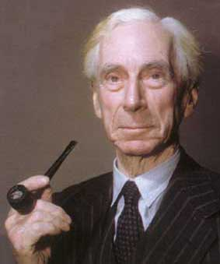
This version of Set Theory is inconsistent
Russell’s paradox:
Consider the set that corresponds with the predicate x ∉ x :
S = {x | x∉x }.
Now ask: is S∈S?
Bertrand Russell
1872-1970
Notes:
Turn into exercise!
See note about ZF in the earlier slide near the start of this module.
Bertrand Russell was the guy who discovered this particular pathalogical example. The question of whether it is a member of itself is known as “Russell’s Paradox.”

Slide 19
Russell’s paradox
Let S = {x | x∉x }. Is S∈S?
If S∈S, then S is one of those objects x for which x∉x. In other words, S∉S
By Reductio, we have S∉S
If S∉S, then S is not one of those objects x for which x∉x. In other words, S∈S
By Reductio, we have S∈S
We conclude that both S∈S and S∉S
Paradox! (There’s no assumption that we can blame, so we cannot Reductio again)
Notes:
Turn into exercise!
See note about ZF in the earlier slide near the start of this module.
Bertrand Russell was the guy who discovered this particular pathalogical example. The question of whether it is a member of itself is known as “Russell’s Paradox.”

Slide 20
Power Sets

Slide 21
The Power Set Operation
The power set P(S) of a set S is the set of all subsets of S. P(S) :≡ {x | x⊆S}.
E.g. P({a,b}) = {∅, {a}, {b}, {a,b}}.
Sometimes P(S) is written 2^{S}, because
|P(S)| = 2^{|S|}.
It turns out ∀S:|P(S)|>|S|, e.g. |P(N)| > |N|.
There are different sizes of infinite sets!
Notes:
We’ll get to different sizes of infinite sets later, in the module on functions.

Slide 22
Examples
P({0, 1, 2})
={∅,{0},{1},{2},{0,1},{1,2},{0,2},{1,2},{0,1,2}}
P({∅})={∅, {∅}}
P(∅)={∅}

Slide 23
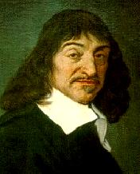
Cartesian Products of Sets
For sets A, B, their Cartesian product
A×B :≡ {(a, b) | a∈A ∧ b∈B }.
E.g. {a,b}×{1,2} = {(a,1),(a,2),(b,1),(b,2)}
{John,Mary,Ellen}x{News,Soap}=
René Descartes
(1596-1650)
Notes:
Usually AxBxC is defined as {(a,b,c) | a is in A and b is in B and c is in C}.

Slide 24
Cartesian Products of Sets
For sets A, B, their Cartesian product
A×B :≡ {(a, b) | a∈A ∧ b∈B }.
E.g. {a,b}×{1,2} = {(a,1),(a,2),(b,1),(b,2)}
{John,Mary,Ellen}x{News,Soap}=
{(John,News),(Mary,News),(Ellen,News),
(John,Soap),(Mary,Soap),(Ellen,Soap)}
If R is a relation between A and B then R⊆AxB
Notes:
Usually AxBxC is defined as {(a,b,c) | a is in A and b is in B and c is in C}.

Slide 25
Cartesian Products of Sets
Note that
  for finite set A, B, |A×B| = |A|.|B|
  the Cartesian product is not commutative: i.e., ¬∀AB: A×B=B×A.
  notation extends naturally to A₁ × A₂ × … × A_{n}
  Other examples: Example 15-16
Notes:
Usually AxBxC is defined as {(a,b,c) | a is in A and b is in B and c is in C}.

Slide 26
Using Set Notation with Quantifiers
∀x∈S P(x) denotes the universal quantification
∃x∈S P(x) denotes the existential quantification
∀x∈R (x^2≥0) and ∃ x∈Z (x^2=1)

Slide 27
Set Operations

Slide 28
Start §2.2: The Union Operator
For sets A, B, their union A∪B is the set containing all elements that are either in A, or (“∨”) in B (or, of course, in both).
Formally, ∀A,B: A∪B = {x | x∈A ∨ x∈B}.
Note that A∪B is a superset of both A and B (in fact, it is the smallest such superset):
∀A, B: (A∪B ⊇ A) ∧ (A∪B ⊇ B)

Slide 29
Union Examples
{a,b,c} ∪ {2,3} = {a,b,c,2,3}
{2,3,5} ∪ {3,5,7} = {2,3,5,3,5,7} ={2,3,5,7}
2
5
3
7

Slide 30
The Intersection Operator
For sets A, B, their intersection A∩B is the set containing all elements that are simultaneously in A and (“∧”) in B.
Formally, ∀A,B: A∩B={x | x∈A ∧ x∈B}.
Note that A∩B is a subset of both A and B (in fact it is the largest such subset):
∀A, B: (A∩B ⊆ A) ∧ (A∩B ⊆ B)

Slide 31
Intersection Examples
{a,b,c} ∩ {2,3} = ___
{2,4,6} ∩ {3,4,5} = ______
∅
{4}
Think “The intersection of University Ave. and W 13th St. is just that part of the road surface that lies on both streets.”
3
2
4
6
5

Slide 32
Disjointness
Two sets A, B are called
disjoint (i.e., not joined)
iff their intersection is
empty. (A∩B=∅)
Example: the set of even
integers is disjoint with
the set of odd integers.

Slide 33
Inclusion-Exclusion Principle
How many elements in A∪B?
Can you think of a general formula?
(Express in terms of |A| and |B| and
whatever else you need.)
Notes:
We will see this basic counting principle again when we talk about combinatorics.

Slide 34
Inclusion-Exclusion Principle
How many elements are in A∪B?
|A∪B| = |A| + |B| − |A∩B|
Example: How many students are on our class email list? Consider set
E = I ∪ M,
I = {s | s turned in an information sheet}
M = {s | s sent the TAs their email address}
Some students may have done both!
|E| = |I∪M| = |I| + |M| − |I∩M|
Notes:
We will see this basic counting principle again when we talk about combinatorics.

Slide 35
Set Difference
For sets A, B, the difference of A and B, written as A−B, is the set of all elements that are in A but not in B. Formally:
A − B :≡ {x | x∈A ∧ x∉B}
Also called:
The complement of B with respect to A.
Notes:
NOT (x in A -> x in B) = NOT (x not in A or x in B) (defn. of implies) = x in A AND x not in B (DeMorgan’s law).

Slide 36
Set Difference Examples
{1,2,3,4,5,6} − {2,3,5,7,9,11} =
___________
Z − N = {… , −1, 0, 1, 2, … } − {0, 1, … }
= {x | x is an integer but not a nat. #}
= {x | x is a negative integer}
= {… , −3, −2, −1}
{1,4,6}

Slide 37
Set Difference - Venn Diagram
A−B is what’s left after B
“takes a bite out of A”
Chomp!
Set
A−B
Set A
Set B

Slide 38

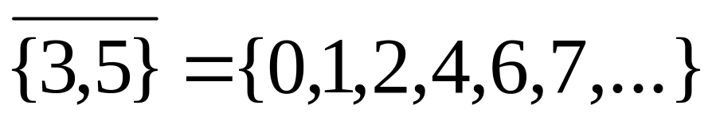
Set Complements
The universe of discourse itself can be considered a set, called U.
When the context clearly defines U, we say that for any set A⊆U, the complement of A, written , is the complement of A w.r.t. U, i.e., it is U−A.
E.g., If U=N,

Slide 39
Set Identities, Generalized and Intersections

Slide 40
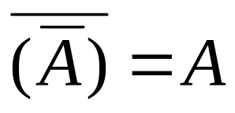
Set Identities
A∪∅ = A = A∩U
A∪U = U
A∩∅ = ∅
A∪A = A = A∩A
A∪B = B∪A
A∩B = B∩A
A∪(B∪C)=(A∪B)∪C A∩(B∩C)=(A∩B)∩C

Slide 41
(don’t worry about their names)
Identity: A∪∅ = A = A∩U
Domination: A∪U = U , A∩∅ = ∅
Idempotent: A∪A = A = A∩A
Double complement:
Commutative: A∪B = B∪A , A∩B = B∩A
Associative: A∪(B∪C)=(A∪B)∪C ,
A∩(B∩C)=(A∩B)∩C

Slide 42
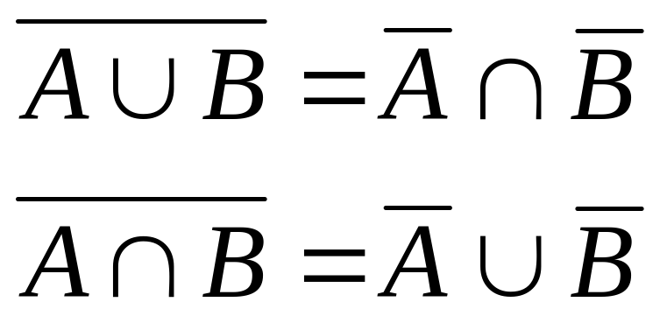
DeMorgan’s Law for Sets
Exactly analogous to (and provable from) DeMorgan’s Law for propositions.

Slide 43
Proving Set Identities
To prove statements about sets, of the form
E₁ = E₂ (where the Es are set expressions), here are three useful techniques:
1. Prove E₁ ⊆ E₂ and E₂ ⊆ E₁ separately.
2. Use set builder notation &
logical equivalences.
3. Use a membership table.
Notes:
A membership table is like a truth table.

Slide 44
Method 1: Mutual subsets
Example: Show A∩(B∪C)=(A∩B)∪(A∩C).
Part 1: Show A∩(B∪C)⊆(A∩B)∪(A∩C).
Assume x∈A∩(B∪C), & show x∈(A∩B)∪(A∩C).
We know that x∈A, and either x∈B or x∈C.
Case 1: x∈B. Then x∈A∩B, so x∈(A∩B)∪(A∩C).
Case 2: x∈C. Then x∈A∩C , so x∈(A∩B)∪(A∩C).
Therefore, x∈(A∩B)∪(A∩C).
Therefore, A∩(B∪C)⊆(A∩B)∪(A∩C).
Part 2: Show (A∩B)∪(A∩C) ⊆ A∩(B∪C). (analogous)

Slide 45
Method 2: Mutual subsets
A variant of this method: translate into propositional logic, then reason within propositional logic, and finally translate back into set theory. E.g.,
Show A∩(B∪C)⊆(A∩B)∪(A∩C).
Suppose x∈A ∧ (x∈B ∨ x∈C).
Prove (x∈A ∧ x∈B) ∨ (x∈A ∧ x∈C).

Slide 46
Method 3: Membership Tables
Just like truth tables for propositional logic.
Columns for different set expressions.
Rows for all combinations of memberships in constituent sets.
Use “1” to indicate membership in the derived set, “0” for non-membership.
Prove equivalence with identical columns.

Slide 47
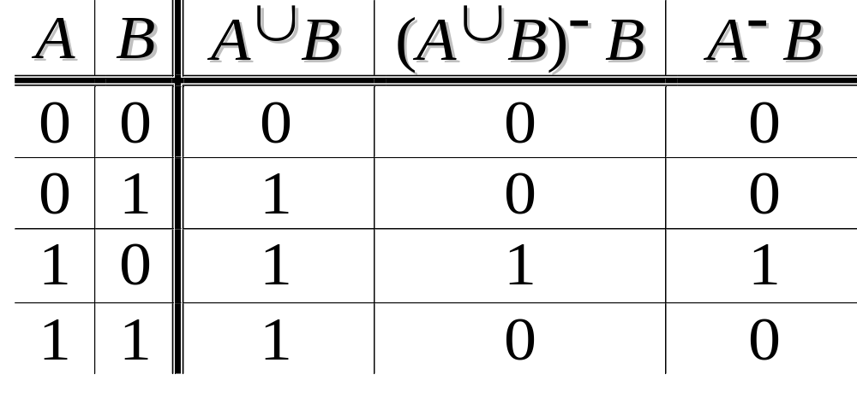
Membership Table Example
Prove (A∪B)−B = A−B.
Notes:
There are 4 basic kinds of elements (i.e.,basic regions of the Venn diagram):
the ones that are in neither A nor B, the ones that are in B but not A, etc. Everything
analogous to truth tables, but based on the different regions of a Venn diagram.
The proof shows that the two formulas cover the same basic regions of the diagram,
That is, the same kinds of objects.

Slide 48
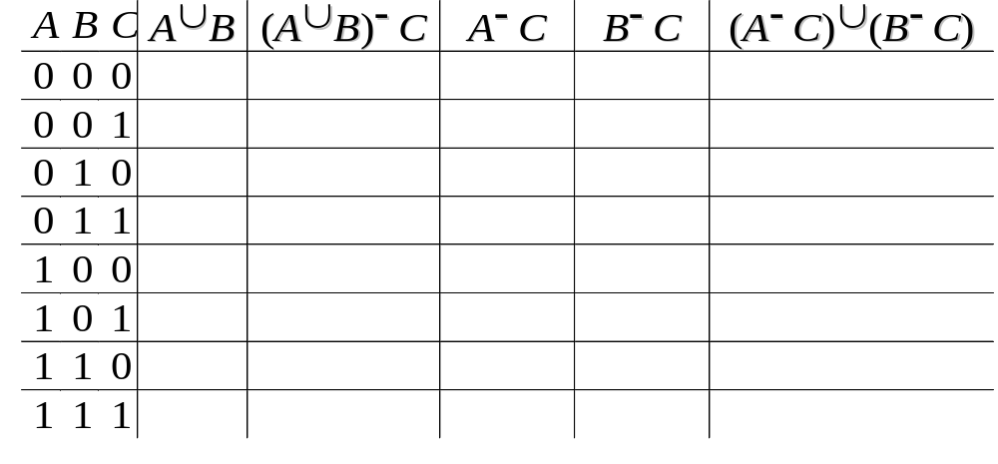
Membership Table Exercise
Prove (A∪B)−C = (A−C)∪(B−C).

Slide 49
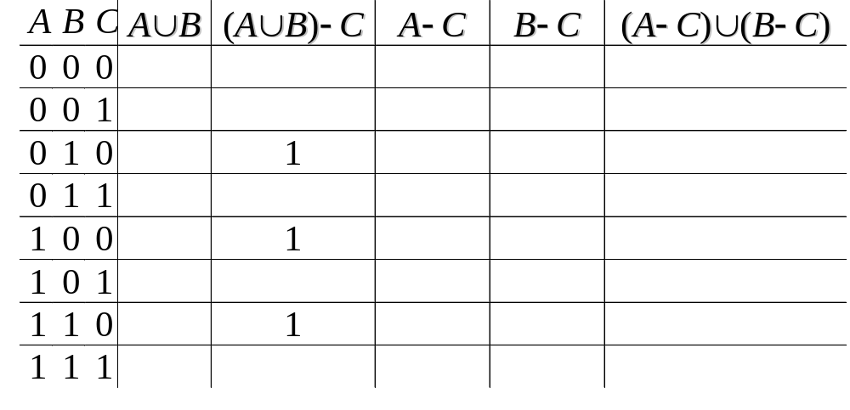
Membership Table Exercise
Prove (A∪B)−C = (A−C)∪(B−C).

Slide 50
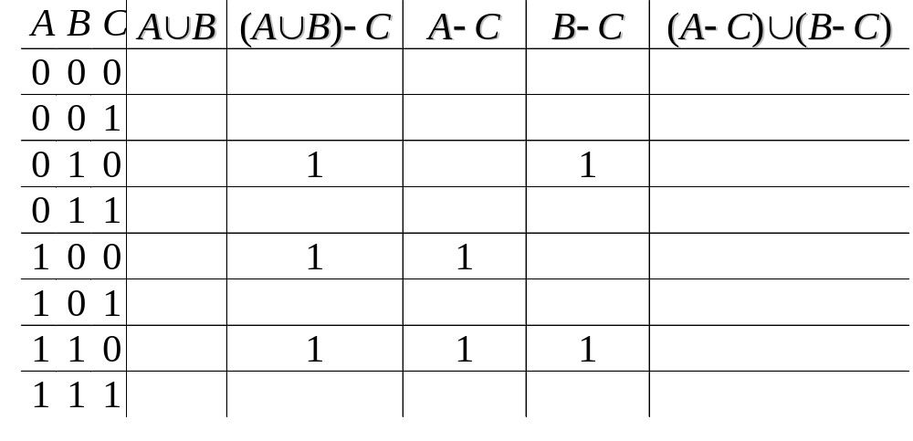
Membership Table Exercise
Prove (A∪B)−C = (A−C)∪(B−C).

Slide 51
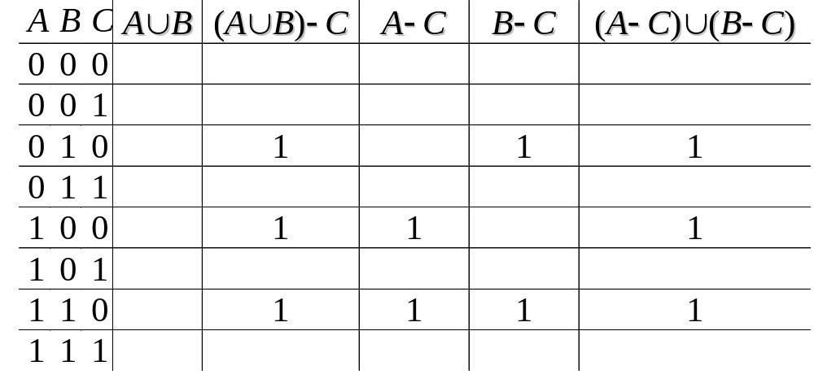
Membership Table Exercise
Prove (A∪B)−C = (A−C)∪(B−C).

Slide 52

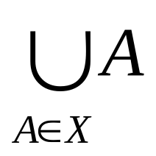
Generalized Union
Binary union operator: A∪B
n-ary union:
A∪A₂∪…∪A_{n} :≡ ((…((A₁∪ A₂) ∪…)∪ A_{n})
(grouping & order is irrelevant)
“Big U” notation:
Or for infinite sets of sets:

Slide 53
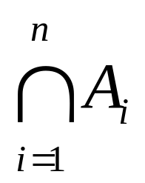
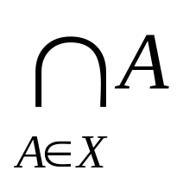
Generalized Intersection
Binary intersection operator: A∩B
n-ary intersection:
A₁∩A₂∩…∩A_{n}≡((…((A₁∩A₂)∩…)∩A_{n})
(grouping & order is irrelevant)
“Big Arch” notation:
Or for infinite sets of sets:

Slide 54
Computer Representation
of Sets

Slide 55
Representing Sets with Bit Strings
For an enumerable u.d. U with ordering
x₁, x₂, …, represent a finite set S⊆U as the finite bit string B=b₁b₂…b_{n} where
∀i: x_{i}∈S ↔ (i<n ∧ b_{i}=1).
E.g. U=N, S={2,3,5,7,11}, B=01101010001.
In this representation, the set operators
“∪”, “∩”, “-” are implemented directly by bitwise OR, AND, NOT!
Notes:
So, for example, on a 64-bit processor, using just a single machine-language instruction you can calculate the union or intersection of two sets out of a universe of discourse having up to 64 elements. This leads to an extremely fast way of doing complicated calculations on small sets. It is not a good method for large, sparsely populated sets, because searching the bit string to find which bits are “1” can take a long time.

Slide 56
Representing Sets with Bit Strings
In this representation, the set operators
“∪”, “∩”, “-” are implemented directly by bitwise OR, AND, NOT!
For example, {2,3,5,7,11} ∪ {1,3,4,9} =
01101010001 ∪ 10110000100
= 11111010101
Notes:
So, for example, on a 64-bit processor, using just a single machine-language instruction you can calculate the union or intersection of two sets out of a universe of discourse having up to 64 elements. This leads to an extremely fast way of doing complicated calculations on small sets. It is not a good method for large, sparsely populated sets, because searching the bit string to find which bits are “1” can take a long time.

Slide 57
Application

Slide 58
集合计数
某个研究所有170名职工，其中120人会英语，80人
会法语，60人会日语，50人会英语和法语，25人会英语
和日语，30人会法语和日语，10人会英语、日语和法语。
问有多少人不会这三种语言？

Slide 59
集合计数
解:令U为全集，E、F、J分别为会英语、
法语和日语人的集合。|U|=170
|E|=120 |F|=80 |J|=60 |E∩F|=50
|E∩J|=25 |F∩J|=30 |E∩F∩J|=10
|E∪F∪J|=|E|+|F|+|J|-|E∩F|-|E∩J|-|F∩J|+|E∩F∩J|
= 120＋80＋60－50－25－30＋10＝165
|U-(E∪F∪J)|=170-165=5 即有5人不会这三种语言。
U
E
F
10
J

Slide 60
End of the Section 2.1

